Slide 1
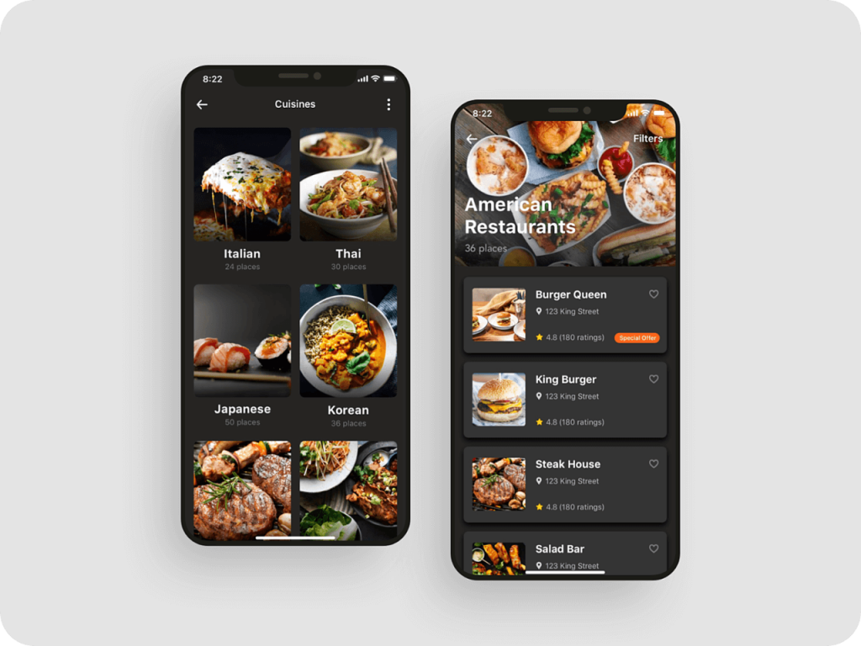
Will provide Great user Experience
through website
User Experience
Our website will provide a great user Experience for the clients who visit our website so that anyone can place their order easily.

Slide 2
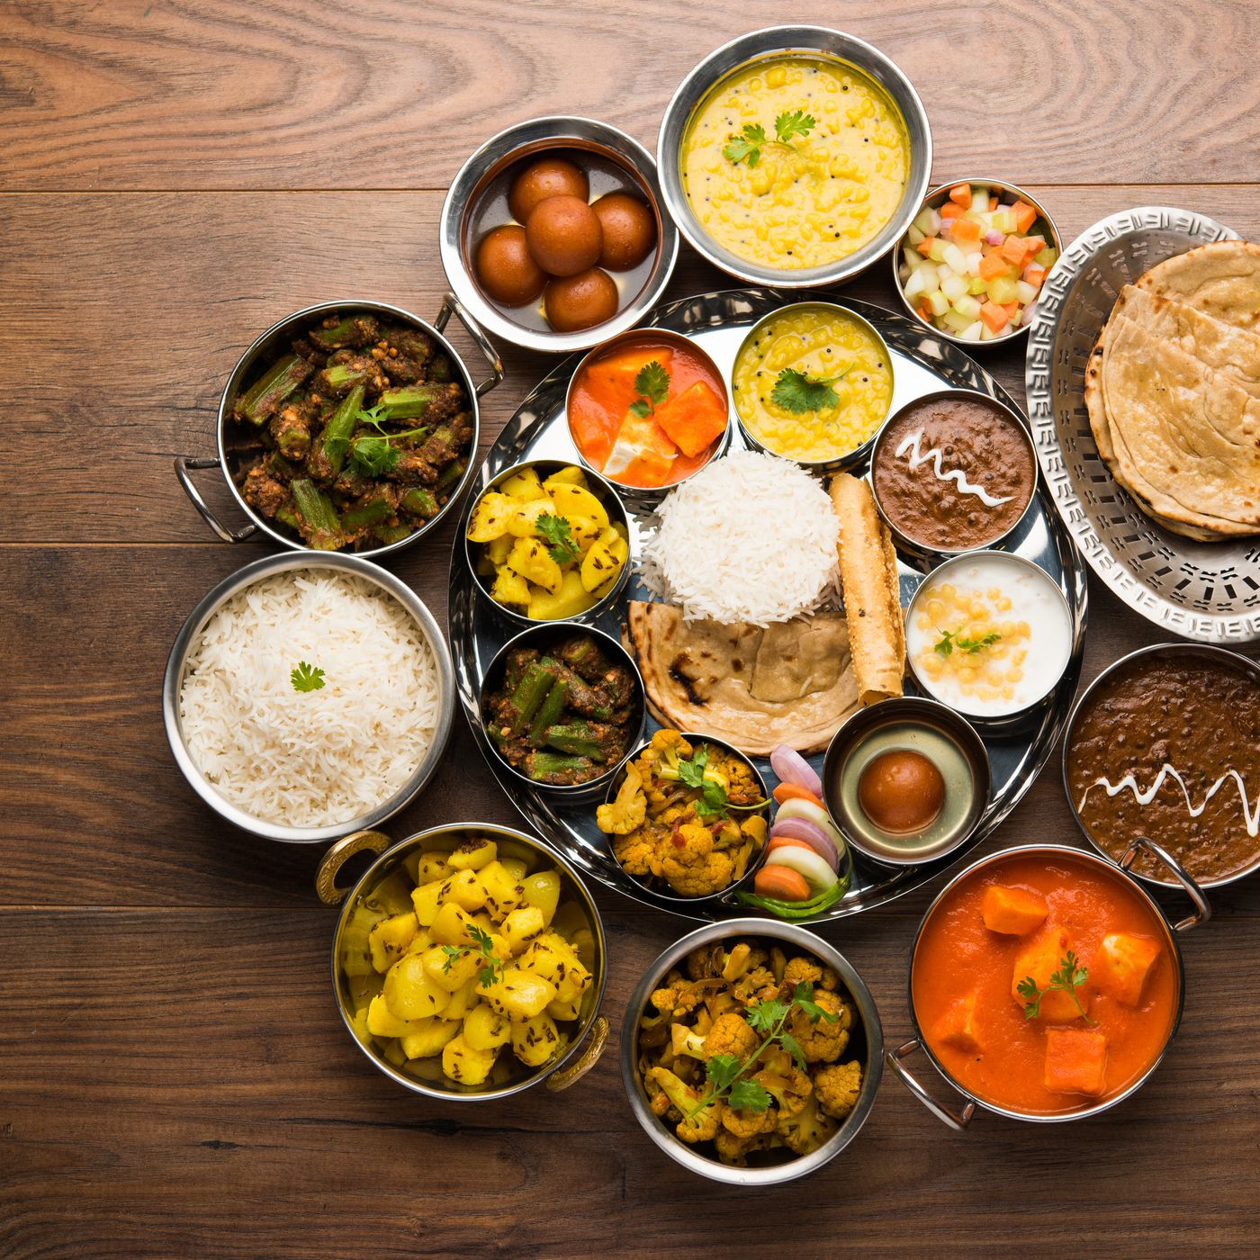
Home Page
We will display the image of restaurant here and all the modules we use in the website will display in the right most corner and when we slide down there is also contact us option where user can easily contact to the management of restaurant and also can follow the restaurant on the social media platform.
About us
Contact Us
Here we will give information to the user about us.
here we will give link of social media platform and contact number also so user can easily get connect with us.

Slide 3
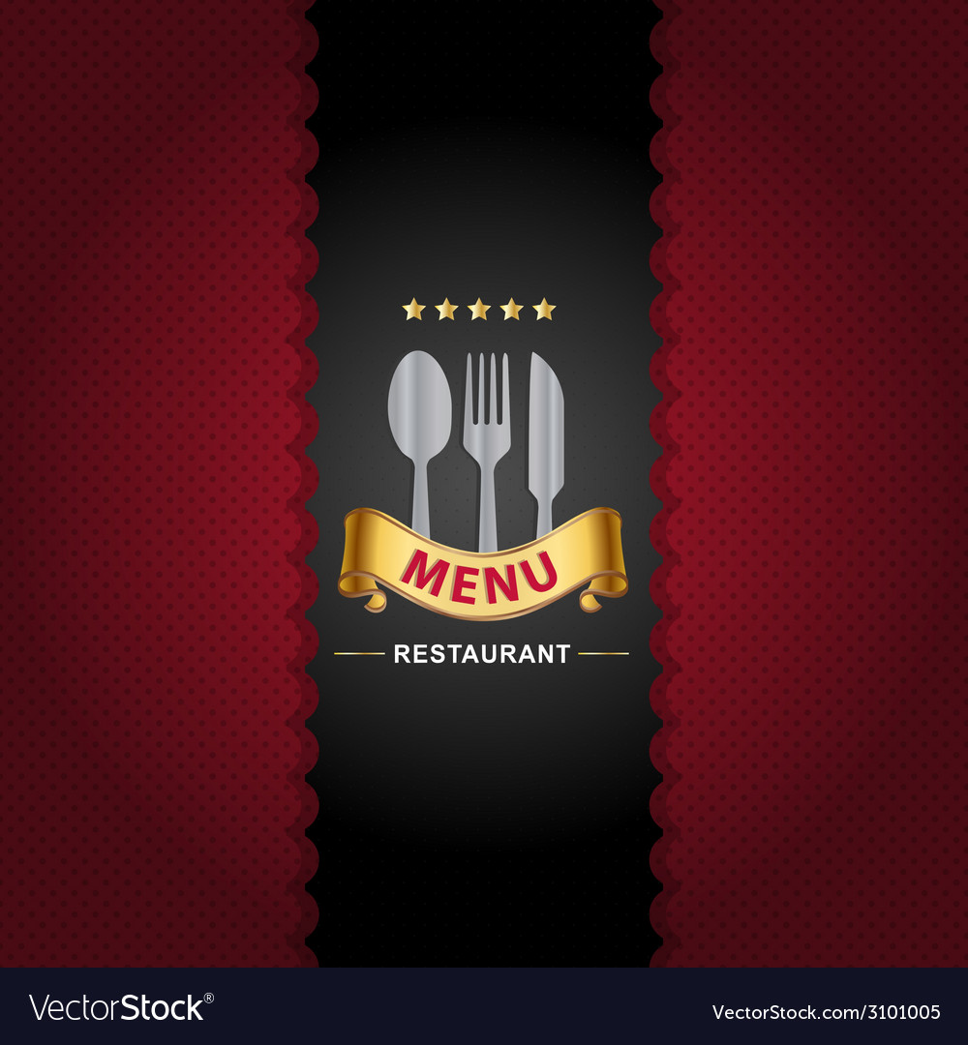

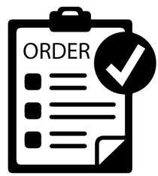
Menu & Orders
Menu
Inside the Menu button user can view the product according to the category (south-Indian, Punjabi, Snacks &Drinks etc.) with price and offer if available in a particular product.
Orders
Client can also place their order online with smoothly with just some click and also automatically bill will also display.

Slide 4
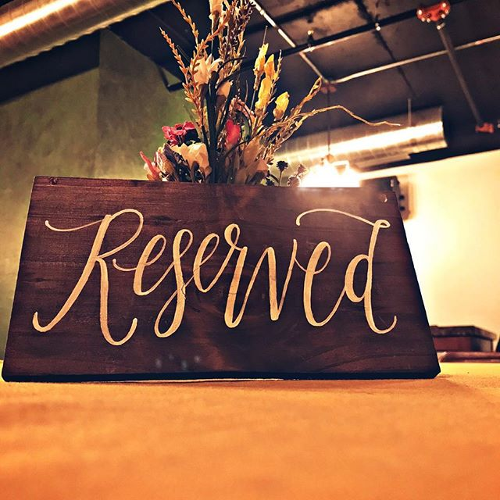
Table-Reservation
Clients can reserve their table with just some click over it. User can easily search if table is available or not, if yes then User can easily book the table so that no other person can reserve that table.

Slide 5

Contact Our Restaurant
Contact Number
Address
A restaurant is a place that people visit to look for various kinds
A restaurant is a place that people visit to look for various kinds
Office Restaurant
Contact Here
A restaurant is a place that people visit to look for various kinds
A restaurant is a place that people visit to look for various kinds

Slide 6


Thank
You

